Slide 1
Public Protection & Integrated Enforcement Organisation Structure & Target Operating Model June 2025

Slide 2
Public Protection & Integrated Enforcement Organisation Structure June 2025
Director of Public Protection & Integrated Enforcement
Commercial Manager
Head of Integrated Enforcement
Head of Substance Misuse
Head of
Public Protection
Head of Regulatory Services
Enforcement Operations & Partnership Manager
Drugs Interventions Programme (DIP) Manager
Senior VAWG, Domestic Abuse & Women's Safety Manager
Development
& Compliance Manager
ASB Manager
Hidden Harm / Family Member
Coordinator
Civil Protection & Business Continuity Manager
Team Leader Trading Standards & Licensing
Environmental Services Manager
Criminal Justice Manager
Prevent & Hate Crime
Manager
Team Leader Food Safety & Health & Safety
Evidence and Insights Manager
Partnership Intelligence Manager
ADDER Accelerator Coordinator
Community Engagement Coordinator
Team Leader Corporate
Health & Safety
Team Leader Public Health Programmes
CCTV Transformation Programme
Manager
CCTV & Specialist Operations Manager
Community Development Officer
Environmental Protection Manager
Street Trading, Markets & Town Centres Manager

Slide 3
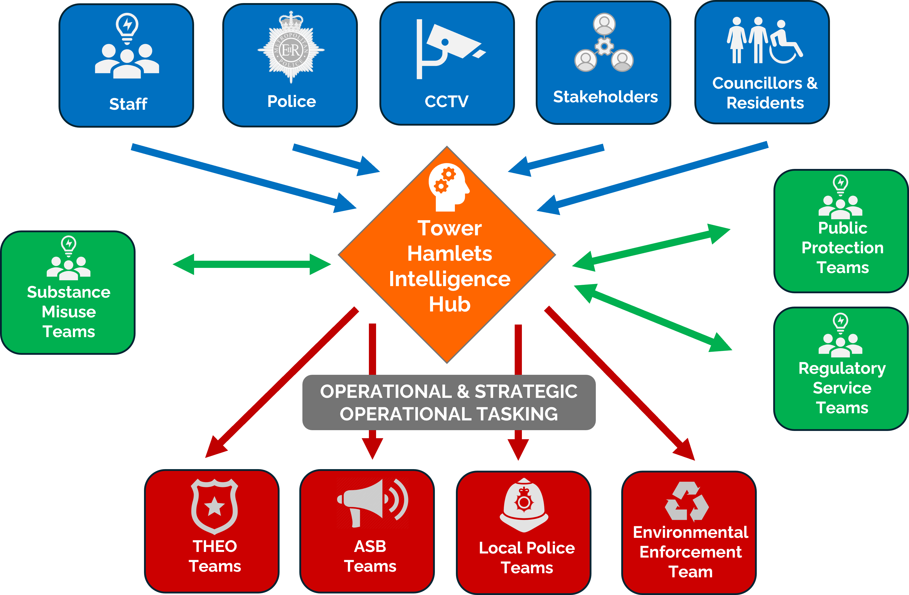
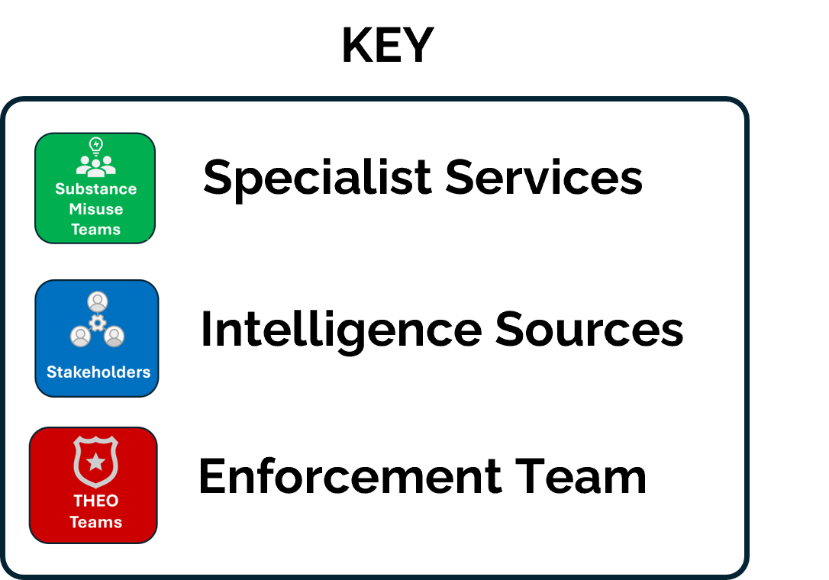
Public Protection & Integrated Enforcement
Target Operating Model June 2025
The new Target Operating Model (TOM) has been developed to illustrate how the new service will operate.
The key to the model is the
development of the Tower Hamlets Intelligence Hub to receive data and information from a variety of internal and external sources.
The hub then supports operational and strategic tasking of the responsive and intelligence led enforcement teams and acts as the conduit to and from specialist council services that play a vital role in case management alongside providing complex, targeted services with key partners.

