Slide 1
Tower Hamlets
Safeguarding Adults Board
Annual Report 2022-23
Safeguarding is everyone’s responsibility

Slide 2
Safeguarding Adults’ Board summary for 2022-23
Volume & Trends
The number of safeguarding concerns decreased by 8.6% this year (1330) compared to last year (1449)
The number of safeguarding enquiries raised has decreased by 16% compared to last year
'Neglect' and 'Acts of Omission' remain the largest single type of abuse investigated in the Borough
The majority of safeguarding issues take place in the victim’s own home and care homes
The number of Deprivation of Liberty Safeguards (DoLs) authorised continues to increase with this year being the highest (370) over the course of 5 years.
2022-23 Achievements
Recognition and creation of a working group to look at substance misuse and housing issues
Implementation of the 'Carer's Passport' project as part of the community engagement group
The 2022 Safeguarding Conference involved those with lived experience
'Deep Dive Audits' completed in Adult Social Care in November 2022
Safeguarding video produced by the Community Engagement subgroup
Developed a prototype of a multi-agency dashboard, to help partner organisations make better decisions based on evidence and data.
2023-24 Priorities:
People with Learning Disabilities - to make sure that through the best scrutiny and governance we are working with people with learning disabilities and their families to minimise the risk of harm
Self-Neglect and Hoarding - to strike a balance between respecting people's rights but acting early, working closely between agencies, to minimise the risk of Hoarding and Self-Neglect
Substance Misuse & Homelessness –build on the extensive provision in Tower Hamlets to make sure that the best practice in housing support for residents with complex care needs and substance misuse issues becomes the standard for all housing providers.

Slide 3
Foreword on behalf of the Independent Chair
I am writing this Foreword following the sudden and sad death of our Independent Chair, Fran Pearson. Fran was a remarkable person, an expert in her field and we were lucky enough to benefit from her passion, commitment and expertise for two years. Our thoughts are with her family at this difficult time.
In 2022/23 the Safeguarding Adults Board has continued to work on raising awareness of safeguarding and abuse, producing an animated YouTube Video for use with the community. We have also continued our focus on learning and supporting staff across the system with training, learning and development around safeguarding. Our annual safeguarding conference continues to be well attended and receive excellent feedback. We are focusing on increasing the voice of people who have used safeguarding services within our approach and have three local residents who are part of the London Safeguarding Voices Group.
The Safeguarding Adults Board has identified a priority around those residents of the borough who led complicated and chaotic lives including those with substance misuse problems and housing insecurity and those at risk of self-neglect and hoarding. We care very much about these residents and want to support staff across the system to work with them to reduce risk, ensure we uphold their rights and intervene early if needed to safeguard and support them. We will also be working with people with learning disabilities this year to ensure that we work to safeguard people in a person-centred way including people who may not live within the borough.
The population in Tower Hamlets is growing and we continue to address challenges of health inequalities and housing need. Last year the number of safeguarding enquiries fell, and the Board will continue to monitor data that provides insights into safeguarding need and the work carried out. Continuing to raise awareness of abuse, risk and safeguarding is an important, ongoing role of the Board. We continue to work within the Making Safeguarding Personal framework and will continue to support people to define the outcomes they want and monitor if these are achieved.
Denise Radley
Interim Chair of Safeguarding Adults Board

Slide 4
Introduction
What is adult safeguarding?
The Care Act 2014 statutory guidance describes adult safeguarding as:
Who does safeguarding apply to?
Safeguarding is everyone's responsibility and the Board has a role to play in assuring our community that ‘adults at risk’ are safeguarded from abuse or neglect. An adult at risk can be anyone aged 18 or over who:
Has care and support needs (even if no agency is involved in meeting those needs) and;
Is experiencing, or at risk of, abuse or neglect; and/ or
As a result of those care and support needs, is unable to protect themselves from either the risk of, or the experiences of abuse or neglect
“Protecting an adult’s right to live in safety, free from abuse and neglect. It is about people and organisations working together to prevent and stop both the risks and experience of abuse or neglect, while at the same time, making sure that the adult’s wellbeing is promoted including where appropriate, having regard to their views, wishes, feelings and beliefs in deciding on any action. This must recognise that adults sometimes have complex interpersonal relationships and may be ambivalent, unclear or unrealistic about their personal circumstances.”

Slide 5
Background
The Care Act 2014 requires Safeguarding Adults Boards to ensure that vulnerable adults are safe, and that agencies work together to promote their welfare. The Act sets out a legal framework for how local authorities and other organisations should protect adults at risk of abuse or neglect.
The board has three core duties:
The Tower Hamlets Safeguarding Adults Board (SAB) Annual Report 2022/23 outlines the work of the Board over the last twelve months and how partner agencies have worked together to improve the safety of adults at risk of abuse.
The report contains details of:
Publish an annual strategic plan
Undertake Safeguarding Adult Reviews
Publish an annual report
How safeguarding has been promoted and developed over the last year
Contributions from board members, chairs of subgroups and other relevant partnerships.
How the Board intends to continue this in the future.

Slide 6
About Tower Hamlets…
Tower Hamlets continues to have one of the fastest growing populations nationally and now has an estimated population of 324,745.
The Median Age in Tower Hamlets was 31.6 – the youngest of any area in England and Wales. The borough had the smallest proportion of older people aged 65+.
At 34.6%, Tower Hamlets has the largest Bangladeshi population in England and Wales and the largest Muslim population (39.9%) in England and Wales. It had the fourth smallest White British population and the smallest Christian population in England.
In 2022, nearly 4,000 older and vulnerable residents received long and short-term care support from the council.
The borough ranks as one of the highest in England for older people living in income deprived households, estimated to be approximately 44% of older people.
Projecting Adult Needs and Service Information (PANSI) projections estimate that over 46,000 people aged between 18-64 will have a common mental disorder by 2024.

Slide 7
Safeguarding adults’ performance data 2022-23
This section presents data and information for 2022-23 in relation to safeguarding adults. It gives an overview of the number of safeguarding concerns that have been received, and the number and type of enquiries (investigations) that have been concluded. Our analysis of this data allows us to identify where improvements are needed and which areas to focus on for the coming year. The council in its lead role for safeguarding has an overview of all safeguarding concerns received within the borough. As such, data from the council’s case management system has been used to inform this section.
Number of safeguarding concerns
In 2022-23, 1,330 adults had safeguarding concerns raised about them in Tower Hamlets, which is a decrease of 8.6% from the year before (1,449 in 2021-22). Generally, this number has been on an upward trajectory for Tower Hamlets over the past 5 years, which we believe is partly reflective of increased awareness of adult abuse and neglect amongst staff and residents in the borough.
Who is being referred?
This year there has been consistency in the profile of people who have concerns (referrals) raised about them compared to last year. The gender ratio has remained consistent with higher numbers of women being subject to safeguarding referrals (56.7%) than men (43.3%). In 2022-23, 45.9% of concerns were about older people aged over 65, down from 46.3% last year and there has also been an increase (53.7%) in the numbers of younger adults aged 18 - 64 years who had concerns raised about them compared to last year.
The ethnic profile of those who have had safeguarding referrals made about them has stayed broadly consistent. This year 52.4% of people had a ‘white’ ethnic background, compared to 53.3% in 2021-22. 28.8% of referrals related to people from an ‘Asian’ ethnic background; a group that makes up over 40% of the total population in Tower Hamlets. Although this is a complex issue and the figures may be impacted by the age profile of the borough, the Safeguarding Adults Board is committed to understanding the reasons why this is the case and to addressing the disparity.
Safeguarding adult’s enquiries
Safeguarding adult’s enquiries are concerns received that proceed to a safeguarding investigation.
375 people had safeguarding enquiries commenced during 2022-23 which has reduced compared to the total last year (446 people). The ‘conversion rate’ from concerns to enquiries is based on the gross number of cases rather than number of people. This year the rate has decreased to 26% compared to 29% last year.
Following national guidance on the conversion rate from Local Government Association and ADASS, the council has analysed its data to ensure it reflected this and continues to monitor the rate closely.
Overall, there were 391* concluded safeguarding adults’ enquiries, a decrease from 428 last year
------------------------------------------
*Note that this figure differs to the enquiries commenced as that is counted per individual. Some individuals have may have more than one safeguarding incident and complex enquiries may involve multiple types of abuse, each is recorded separately.

Slide 8
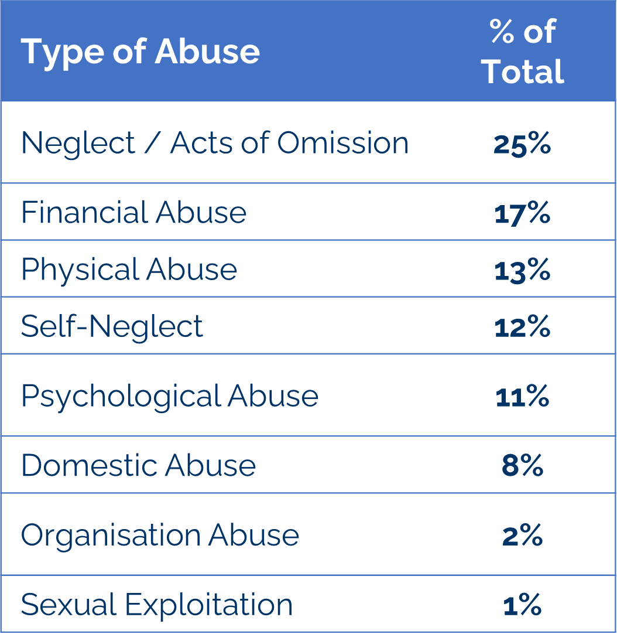
Safeguarding adult’s performance data 2022-23 continued
Where the abuse takes place
Based on concluded safeguarding investigations, 60% of safeguarding issues took place in the victim’s own home, a 7% drop compared to 2021-22. Enquiries related to people in care homes in 2022-23 was 20%, an increase to the previous year (8%) and enquires related to hospital settings was 10% up from 8% in 2021-22.
The low proportion of enquiries from care homes in Tower Hamlets compared to the national average reflects the small number of residential and nursing care homes in the borough.
The Board have looked at detailed information on the quality of home care and care homes in the borough and at the systems in place to safeguarding people receiving support.
Types of abuse
'Neglect' and 'Acts of Omission’ were the largest single types of abuse
investigated in Tower Hamlets in 2022- 23, comprising 25% of all abuse, down from 28% in the previous year. The full breakdown is given in the table below.
Safeguarding enquiries outcomes -managing risk
Safeguarding and risk management can be complex processes with a number of factors that will render a person or situation being at risk.
Where risk cannot be completely removed, strategies are in place to monitor and inform the individual of what support is available to them.
In the highest proportion of completed enquiries the risk to the individual has been reduced – 37% for 2022-23. The risk was fully removed in 18% of enquiries – same as the previous year. The risk remained in 9% of closed enquiries, a drop from 14% compared to last year.
Making Safeguarding Personal (MSP)
Making Safeguarding Personal (MSP) is intended to make safeguarding more person centred, develop more meaningful engagement of people in safeguarding and improve outcomes.
It continues to be central to the SAB strategic planning and subgroup activity such as through analysing data outcomes, creating opportunities for Partners to collaborate, address emerging concerns both locally and
nationally and ensure the best interest process is followed, including the use of independent advocacy as best practice for the vulnerable.
Where the Desired Outcome is Expressed, 77% expressed an outcome they wanted, up by 5% from 2021-22 and 12% were asked but did not provide an expressed outcome, an increase of 2% from 2021-22.
It is known that the person’s desired outcome may not always be achievable. During 2022/23, it was recorded that 69% had outcomes met or partially met, an increase of 4% compared to last year. Furthermore, 31% expressed their desired outcome was not achieved or not recorded yet.

Slide 9
Safeguarding adult’s performance data 2022-23 continued (2)
Deprivation of Liberty Safeguards performance data
The Deprivation of Liberty Safeguards (DoLS) is a 2007 amendment to the Mental Capacity Act 2005. The Mental Capacity Act allows restraint and restrictions to be used but only if they are in a person’s best interests and they lack capacity to make decisions about their care or treatment.
The Liberty Protection Safeguards (LPS) which were introduced in the Mental Capacity (Amendment) Act 2019 and were meant to replace the Deprivation of Liberty Safeguards (DoLS) system has since been put on hold for the life of this government administration.
During 2022-23, there was an increase in DoLS referrals and the number of DoLS authorised was the highest (370) since 2018-19. This is partially due to a new care home opening that has led to an increase
in demand. Whilst the LPS implementation is on hold, we continue to provide training around mental capacity and DoLS across the partnerships.
The majority (approximately 76%) of all DoLS request received in 2022-23 were from care homes. Hospitals accounted for nearly 18% whilst the
remainder of requests were from hospice/other agencies. Throughout the previous two years, care homes accounted for 72% and 69% of all DoLS requests respectively.
In 2022-23, saw an improvement in the waiting list for allocation of DoLS applications, with all applications being allocated to Best Interest Assessors (BIAs) upon receipt leaving no waiting list.
 | 2022-23 | 2021-22 | 2020-21 | 2019-20 | 2018-19
Total DoLs request received | 578 | 537 | 519 | 596 | 630
DoLs authorised | 370 | 336 | 224 | 293 | 213
DoLs not authorised | 27 | 27 | 45 | 80 | 30
DoLs withdrawn | 181 | 149 | 250 | 223 | 341

Slide 10
Funding for the Safeguarding Adults Board 2022-23
Section 43, Schedule 2 of the Care Act 2014 (“the Act”) allows a ‘partner’ to make payment towards expenditure incurred by or the purposes connected with the Tower Hamlets Safeguarding Adults Board. It is acknowledged that every organisation faces financial challenges each year; therefore, it is with appreciation that partner members give their time and resources to support the functioning of the board.
This funding covers the cost of the Independent Chair, Safeguarding Adult Reviews and Board Management. The tables below set out the level of the partner contributions in relation to the Board for 2022-23:
Local authority contribution: £74,900
Integrated Care Board: £50,000
East London NHS Foundation Trust: £14,900
Barts Health NHS Trust: £5,000
Metropolitan Police: £5,000

Slide 11
Learning and Development over 2022-23
Tower Hamlets council provides a range of safeguarding adults’ training for staff at all levels, designed to raise staff awareness and skills so that they are better equipped to identify and respond to safeguarding concerns. Courses include an adult safeguarding course, enquiry officer training, safeguarding adult's manager course, an intermediate safeguarding programme as well as modern day slavery. Bespoke training is also available on topics including hoarding, human trafficking and female genital mutilation.
Partner agencies also provide a range of training for their staff. Safeguarding Adults basic awareness e-learning is a web-based training portal and is available to all Tower Hamlets staff and those working in the private, independent sectors, carers and volunteers working with adults. Training is provided free of cost to the recipient.
Evaluation on our training sessions plays an important part in helping us monitor the practice nature of the learning, the course structure and knowledge. Below are some of the feedback we have received from our attendees:
‘Knowledge and skills gained from this session will enable me to provide better service when working with service users who may be at risk of harm or potential harm.’
‘I have gained more insight in signs to look for when triaging concerns, whether an adult appears intimidated or closed off.’
‘Excellent sessions focused on making Safeguarding personal and really discussing the nitty-gritty of people’s lives and thinking in a trauma-focused way of how people perceive our enquiries as well as what other aspects of their life help or hinder investigations.’
‘The training was well coordinated and refreshing.’
Safeguarding Adults Managers
(21 attendees)
Enquiry Officer & Managers Refresher
(39 attendees)
Safeguarding Adults Intermediate
(22 attendees)
Safeguarding Adults Basic Awareness
(51 attendees)
Enquiry Officer
(48 attendees)
Safeguarding Training delivered 2022-23

Slide 12
Safeguarding Adults Board achievements over 2022-23
The priorities for 2022-23 came from the Safeguarding Adults Board Strategy of 2019-24 and the Spring 2023 SAB workshop. Each priority was built into the business plan relating to the six principles of safeguarding. The importance of supporting people in a personalised way runs throughout these principles in order to promote ‘Making Safeguarding Personal’. The business plan is monitored by the Safeguarding Adults Board, whilst the work is undertaken via the sub-groups. Each partner agency has worked to ensure their organisation continues to provide a service, that the workforce receives safeguarding training and understands how to recognise abuse respond to it. A summary of the work carried out is below.
Empowerment
Our goals – people being supported and encouraged to make their own decisions and give informed consent.
Poplar Harca: “We work with many different residents, some of which don’t meet the threshold for Social Services, so we help to bridge the gap and look for alternative means of support. On every case we have we support the individual to make their own decisions on what support they would like; we will talk to them about all possible options and then allow them to decide which route they would like to take.”
Tower Hamlets Council: “The 2022 Safeguarding Conference involved those with lived experience which brought significant value to the process. The local authority is exploring avenues for inviting further feedback from service users as part of the safeguarding intervention.”
North East London Integrated Care Board: “The Integrated Care Board has a Quality and Equality, Health Inequality Impact assessment to look at the impact of commissioning plans on vulnerable service users, in particular protected characteristics as well as groups such as homeless people, those with a learning disability, mental health condition or older adults.”
Prevention
Our goals – it is better to take action before harm occurs
Barts Health Trust: “There are clear forms and triggers around capacity during a patient’s admission with referrals to safeguarding team if there are concerns. The missing patient /absconding /self-discharge policy is also being reviewed and will include a review by our local safeguarding committee with various senior staff present, reviewing the process and challenges for patients who might want to leave our care against advice.”
Met Police: “Police take statement from vulnerable adults regularly and their views are captured both evidentially and also in subsequent victim personal statements and if required can lead to escalation for further review.”
Tower Hamlets Council: “We held a development day in which we reflected upon the previous year's successes and challenges and examined insight from the safeguarding audits that partners completed. We also identified our short term and medium-term priorities for the Board, which will form the foundation of the Board’s programme of work for the next two years.”

Slide 13
Safeguarding Adults Board achievements over 2022-23
Proportionality
Our goals – The least intrusive response appropriate to the risk presented.
Tower Hamlets Council: “The local authority is in the process of confirming a new quality assurance framework where safeguarding is a key area of focus. Central to this process is the auditing of cases and consultation with those with lived experience e.g. practice week, through which we can assure ourselves that professionals are responding proportionately.”
Barts Health Trust: “Our patient public forum has adopted an outreach model and gone out to where groups meet to hear about their experience in the hospital and share initiatives across the hospital – incorporating their feedback into our work to ensure
proportionality. Key contacts have been through women’s groups.”
North-East London Integrated Care Board: “High risks cases can be raised to the Integrated Care Board safeguarding designated professional who would provide support and guide the process. As part of our role in Safeguarding Adults Reviews, DHR's & LeDeR reviews we would work with partners to ensure learning from such cases that result in a death have learning events.”
Protection
Our goals - support and representation for those in greatest need.
National Probation Services: “Probation have Multi Agency Public Protection Arrangement (MAPPA) in place to ensure appropriate management of risk for those cases that require multiagency solutions. Cases on licence are subject to recall powers to ensure public protection, and community sentence cases are subject to Court breach processes.”
Tower Hamlets Council: “The Local Authority conducts an extensive training programme inclusive of safeguarding and Mental Capacity Act and related areas of support e.g. trauma informed and strength-based practice, suicide prevention.”
Met Police: “The Police have systems of checks and balances through supervision which can detect anomalous decision making – combined with central inspections carried out internally in additional to external auditors such the Her Majesty Inspectorate Constabulary (HMIC).”

Slide 14
Safeguarding Adults Board achievements over 2022-23
Partnership
Our goals - local solutions through services working with their communities. Communities have a part to play in preventing, detecting and reporting neglect and abuse.
Probation: “We have built and developed strong relationships to support those with substance misuse challenges, with co-location of Drug Intervention Programmes and Project ADDER commissioned workers at the probation office.
Tower Hamlets Council: “Adult Social Care is progressing its quality assurance framework with a specific lens on involving those with lived experience. This has involved forging a relationship with specific service user groups who have agreed to support us on policy development and learning with regards to what is working and not working in ASC”.
Poplar HARCA: “The Safeguarding Team have always worked closely in partnership with other services including the Police, Adult Social Services and Community Mental Health Team (CMHT). We also work with local IDVA services and other third-party agencies to ensure that the resident has the best possible support in place. Information is only shared when necessary and when we feel referrals to partner agencies are needed, as the level of support may go beyond what Poplar HARCA can provide, the resident is informed of what is happening and why referrals are being made, unless we believe by doing so places someone at risk of harm.”
Accountability
Our goals - accountability and transparency in delivering safeguarding.
Tower Hamlets Council: “ASC is seeking to tailor our MCA training to specifically focus on key issues identified within our most recent SAR, which is due to be published soon. Safeguarding training is also being quality-assured in line with key recommendations from SARs”.
Police: “Recent SARs have driven changes in working practice. For example, when a person attends and confesses to a crime that has not yet not been recorded, that person should be invited into the station and interviewed whilst not under arrest. This will allow a risk assessment to take place that can identify risk and the appropriate referrals pending clear identification of the victim and evidence gathering.”.
Poplar HARCA: “Experience from a SAR led us to specifically look at how quickly cases are moving forward and how long we were waiting for responses from all services, notably social workers, when we had serious concerns about a resident. We ensured that we updated our escalation processes to ensure that if we had not received responses from these agencies within set timescales then this was escalated to management level. We have seen that this has greatly improved action being taken, and we have been able to ensure that resident's risk is managed in a timely manner.

Slide 15
Summary of achievements by the Safeguarding Adults Board and partner agencies
Our priority last year:
Continue to deliver safeguarding training to colleagues and staff across the partnership ensuring it is accessible and effective
What we have done:
The Learning and Communication subgroup of the SAB organised the annual Safeguarding Conference in November 2022 with over 100 attendees present. The key focus of the event was on Self-Neglect. The conference explored the latest research on the topic and service user insight, with a keynote presentation from Dr David Orr, a senior Lecturer in Social Work at the University of Sussex.
The Board organised a development day where the focus was to look to the future and seek partner views on what the board’s workstreams need to deliver in 2023 –24 through development of the Board’s work plan.
This was well received and the successful development day set out collectively agreed ambitions to create a process map pathway for all partners to use as well as case studies to aid learning for all partners.
Our priority last year:
Engage with the community around safeguarding using different channels and networks in order to raise safeguarding awareness
What we have done:
The Community Engagement subgroup of the SAB organised safeguarding awareness through the promotion of an animated video on YouTube called ‘What is Safeguarding Adults?’; it was shown during safeguarding month and promoted in faith-based places, other community groups as well as to the No Place for Hate Forum, the No to Hate Champions, Adult Social Care forums and to other partners.
Implementation of the carer’s passport project as part of the community engagement group was rolled out to recognise the dedication and contribution made by unpaid informal carers in the community, who will now be eligible for local discounts such as at the hospital canteen, coffee shops, gym, theatres and more.
In a further show of appreciation, special lanyards with a card to identify themselves as a carer and carers passport was given to carers to allow for greater community recognition of those who do so much to support their family, friends and relatives.
Our priority last year:
Continue to better embed learning and monitor actions from Safeguarding Adult Reviews
What we have done:
The SAB commissioned a themed Safeguarding Adults Review of two adults with similar health issues and complexities, which is due to be published in 2022-23.
SAR learning from already published reviews were monitored by the SAR subgroup throughout the year, with work underway to ensure that previous SAR recommendations are thoroughly embedded and evidenced. This is also a standing agenda item for the SAR Sub-Group and for SAB to discuss the implementation and monitoring of the action plan from SAR reviews.
In October 2022, the SAR Subgroup Terms of Reference was updated to better clarify the role, responsibility, authority and accountability regarding actions each partner should take to ensure the protection of service users and establish how it will hold partners to account and gain assurance of the effectiveness of its arrangements.

Slide 16
Summary of achievements by the Safeguarding Adults Board and partner agencies (continued)
Our priority last year:
Involve service users with lived experience into the work of the SAB, particularly around community engagement activity
What we have done:
Tower Hamlets became one of the first boroughs in London to recruit three service users with lived experience into the London Safeguarding Voices Group (LSVG), a group which is intended to bring alive the principles of Making Safeguarding Personal (MSP) by ensuring people with lived experience of safeguarding and their voices are at the heart of safeguarding governance across London.
The SAB also sought the views of service users on their lived experience at the November Safeguarding Conference 2022, where it was highly praised for providing valuable insight. Service users were able to share their views with the following:
‘Making Safeguarding Personal (MSP) should make the person being centre of it, not to just be listened, but make them the real, genuine focus’.
‘Managing risk is really important and having a thorough understanding of the Mental Capacity Act assessments shouldn’t be used to limit people's lives. Where risks are obvious, How can we minimise those risks while still giving maximum Freedom?’
‘The support from families, friends and professionals was important to me in being able to move accommodation in order to feel safe’
Our priority last year:
Develop the multi agency dashboard as a resource to help monitor the impact of the SAB
What we have done:
The Quality Assurance and Performance subgroup meet quarterly to discuss the strategic direction of safeguarding activities and emerging concerns within Tower Hamlets. They make key recommendations to the Board through reviewing data and monitoring trends that provides insight and leads to escalation if required.
The subgroup is developing a prototype of a multi-agency dashboard, to help Partner organisations involved in safeguarding make better decisions based on evidence and data with suggested areas of further insight or analytical work. The first iteration was presented to the SAB early this year where it was received positively, and there are ongoing plans to further develop and finalise the dashboard in the forthcoming year.
The dashboard will be based on the 6 principles of safeguarding with partner agencies contributing to metric findings.
Equalities
Prevention
Protection
Proportionate
Partnership
Accountable

Slide 17
Safeguarding Adults Reviews
Section 44 of the Care Act 2014 places a duty on Safeguarding Adults Boards to arrange a Safeguarding Adults Review (SAR), in cases where an adult has died or experienced significant harm or neglect. The purpose is to ensure learning form the lessons and to prevent situations occurring again. SARs are overseen by the SAR Sub-Group, consisting of representatives from the board’s statutory partners. On conclusion of the SAR, an action plan will be drawn up to ensure the recommendations of the findings are implemented.
The purpose of the SAR is to:
Establish what lessons are to be learnt from a particular case in which professionals and organisations work together to safeguard and promote the welfare of adults at risk.
Identify what is expected to change as a result, to improve practice.
Improve intra-agency working to better safeguard adults at risk.
Review the effectiveness of procedures, both multi-agency and those of individual organisations.
In 2022-23, there was one Safeguarding Adults Review that has now been completed – Mrs O and Mrs N. Full details of all published Safeguarding Adults Reviews can be found on the Tower Hamlets website.
A themed Safeguarding Adults Review (SAR) was conducted for Mrs. N and Mrs. O, of which both elderly women with complex medical needs, who sadly died in September and August of 2019. Mrs. N was an 88-year-old white woman who had complex and longstanding physical health difficulties. She was admitted to the Royal London Hospital in August 2019 at the request of a visiting nurse who noticed her health had deteriorated. On admission, Mrs. N was found to have developed multiple pressure lesions on her body. Although she made a partial recovery, enough to start discharge planning, she sadly died in September 2019. Mrs. O was an 87-year-old woman who was admitted to Royal London Hospital with a grade 4 pressure sore. Her condition deteriorated further over several weeks whilst she was on admission, and she passed away in August 2019. The SAR findings make several recommendations to the SAB and partner agencies. These focus on the following:
Ensuring that a risk assessment tool is used as part of the Hospital Discharge process
Home Care Providers are included following the assessment of needs as part of care and support planning
Ensuring that District Nurse (DN) Pressure Care Plans and Home Care Providers (HCP) Support Plans are shared sufficiently across services.
Exploring secure information sharing IT options
Ensuring sufficient Mental Health Liaison attendance to support staff where adults are discussed at Safety Huddle meetings at GP practices.
The SAR is due to be published on the LBTH website by October 2023

Slide 18
Implementation and learning from Safeguarding Adults Reviews
Safeguarding Adults Reviews (SARs) provide an opportunity for effective multi-agency learning to support safeguarding practice improvement and promote safer outcomes for adults at risk. LBTH Adult Social Care are learning from SARs in the following ways:
Learnings and recommendations to inform and include:
Strengthening our MCA understanding and application
Improving our partnership working and communication
Embedding a Trauma Informed approach to our practice and service
Recognising Domestic Abuse, including Coercive Control and taking action
We are driving forward practice change in the following ways:
Ensuring our training partners fully understand our development needs and they are robustly meeting our learning needs
Working with trainers to include LBTH case studies and ensure learning is strongly connected to real practice and the needs of Tower Hamlets residents
Ensuring that our safeguarding audit tool and guidance allows us to focus more keenly on practice development areas, reflect the 6 safeguarding principles (Care Act, 2014) and align with the Care Quality Commission (CQC) ratings
Employing Thematic Safeguarding audits (in addition to our annual Safeguarding ‘deep-dive’ Audit and biannual practice audits)
Monitoring recommendations and developing best practices through:
Rebranding our internal SAR monitoring system into a Key Performance Indicator (KPI) format that allows all partners to see and analyse on a regular basis
Escalating issues, concerns and delays through recording meeting minutes and holding partners to account in speeding the recommended actions up as updated in our terms of reference.
The annual report being able to share the work done in the way SAR recommendations are implemented by Partners.

Slide 19
Our priorities for last year (2022-23)
Safeguarding Adult Reviews and other key activity
Community engagement
Utilise social media channels to target key safeguarding messages towards the younger generation of residents in Tower Hamlets
Quality assurance and performance
Continue the development of comprehensive multi-agency dashboard that has a clear focus on outcomes
Learning and communication
Organise and deliver an annual safeguarding conference which focuses on key safeguarding risks identified by the Board and endeavors to include the participation of service users with lived experience
Review the existing training package partners have in place, in order to make sure it is accessible and effective
Conduct an annual deep dive partnership audit focusing on a key safeguarding risk
Monitor the impact & effectiveness of SAR learning and recommendations in partnership with the SAR subgroup
Analyse safeguarding data to establish the impact of on the types of abuse taking place to better inform our approach to safeguarding prevention and awareness raising in the community.
Launch a project that aims to uncover hidden harm through the expertise and knowledge of existing community groups
Refresh and update the digital portal to make it more accessible and easier to navigate for residents
Continue to commission Safeguarding Adult Reviews where necessary, but with a more innovative approach to better embed learning quickly
Monitor the impact and effectiveness of SAR learning and recommendations in partnership with the Quality Assurance and Performance subgroup
Work in partnership with the THCSP to look at issues around all age exploitation and transitional safeguarding
Aim to further involve the views and participation of people with lived experience in the work of the SAB
Produce 7-minute briefings for recently published SARs and disseminate the learning to partners through online learning events
Safeguarding Adults Board Strategy 2019-24
At a strategic level, we have worked to ensure the views and experiences of service users drive our plans: A number of resident service user groups, many of whom with experience of adult social care, contributed to the Safeguarding Adults Board Strategy 2019-24, including the Older Peoples Reference Group, Carers Centre and the Learning Disabilities Partnership Board.
The Board also organised a workshop whereby partners discussed and explored the priorities of the Safeguarding Adults Board, as well as discussing how we can successfully deliver those priorities.

Slide 20
Our priorities for the coming year (2023-24)
We will be influential and let people who live complicated and chaotic lives know that we care about them. We will work with other strategic partnerships in Tower Hamlets to deliver joint plans.
We know that Self-Neglect and Hoarding is an increasing issue. We will publish a toolkit to help professionals, and begin a two year programme to equip professionals to respect people’s rights whilst intervening early enough with the right preventative offer for adults at risk
Some of the most marginalized people in Tower Hamlets have complex care and support needs because of their substance misuse. Housing insecurity is very often a feature of their lives. We want to build on the extensive provision in Tower Hamlets to make sure that the best practice in housing support for this group of residents becomes the standard for all housing providers. We will offer training around mental capacity assessment in recognition that this is an extremely complex and challenging area for practitioners.
We want stronger processes and better evidence to be sure that all our member organisations are using learning from incident reviews in order to improve people’s lives. This year we will test that out and present regular items to the board members, so that we can assure ourselves that systems are robust enough, and that we can pick up on themes and trends. We will track the way training in each organisation improves people’s lives
We want to work with people with learning disabilities to make sure we are doing the best scrutiny and governance possible to keep them safe both within Tower Hamlets and when they are placed away from the borough. Because we know that people with learning disabilities can be particularly vulnerable to certain types of crime, such as cuckooing, we will work with the Community Safety Partnership in Tower Hamlets on some parts of this programme.

Slide 21
Tower Hamlets Safeguarding Adults Board Governance and Accountability
The Care Act 2014 requires all local authorities to set up a Safeguarding Adults Board (SAB) with other statutory partners: the Police and Integrated Care Partnerships (ICPs) Tower Hamlets Safeguarding Adults Board continues to work with partners to embed the requirements of the overarching Care Act to:
Assure that local safeguarding arrangements are in place as defined by the Act
Prevent abuse and neglect where possible
Provide timely and proportionate responses when abuse or neglect is likely or has occurred.
The Safeguarding Adults Board is chaired by an Independent Chair.
The legal framework for the Care Act 2014 is supported by statutory guidance which provides information and guidance on how the Care Act works in practice. The guidance has statutory status which means there is a legal duty to have regard to it when working with adults with care and support needs and carers.
The SAB takes the lead for adult safeguarding across Tower Hamlets to oversee and co-ordinate the effectiveness of the safeguarding work of its members and partner organisations.
The SAB concerns itself with a range of matters which can contribute to the prevention of abuse and neglect such as:
Safety of patients in local health services
Quality of local care and support services
Effectiveness of prisons in safeguarding offenders and approved premises
Awareness and responsiveness of further education services
Safeguarding Adults Boards have three core duties, they must:
Develop and publish an Annual Strategic Plan setting out how they will meet their strategic objectives and how their members and partner agencies will contribute.
Publish an annual report detailing how effective their work has been.
Arrange safeguarding audit reviews for any cases which meet the criteria for such enquires, detailing the findings of any safeguarding adult review and subsequent action, (in accordance with Section 44 of the Act).
The Safeguarding Adults Board monitors and mitigates risk via a shared risk register. The risk register is updated frequently and discussed at the Safeguarding Adults Board when appropriate.

Slide 22
Tower Hamlets Safeguarding Adults Board partner members
The Safeguarding Adults Board (SAB) is made up of representatives from a wide range of organisations and services across the local multi-agency safeguarding partnership, including:

Slide 23
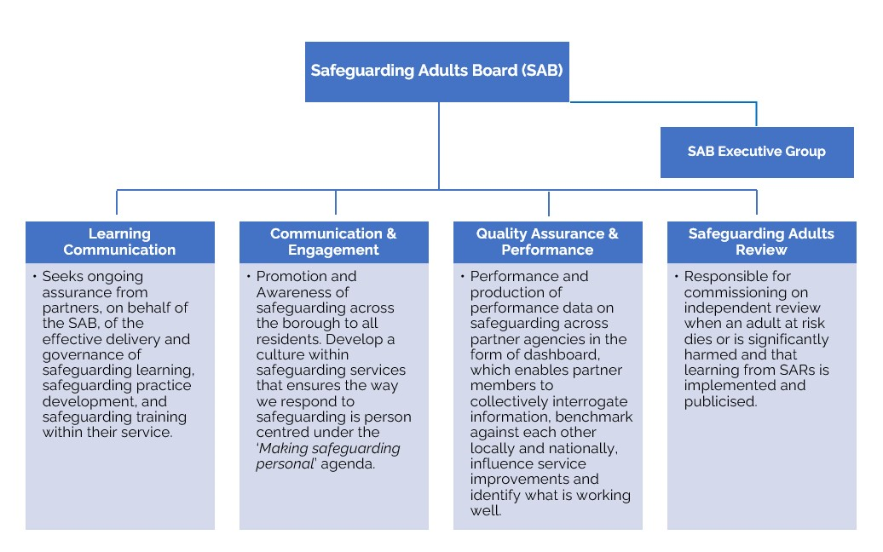
Safeguarding Adults Board (SAB)
Structure
The Tower Hamlets Safeguarding Adults Board is supported by an Independent Chair to oversee the work of the Board, to provide leadership, offer constructive challenge, and work within the remits of the statutory guidelines. The core work of the Board is undertaken by the Sub-Groups and the Partnership Board Unit. The Partnership Board supports the operational running of these arrangements and manages the Board on behalf of the multiagency partnership. The Board facilitate joint working, ensure effective safeguarding work across the borough, and provide consistency to our partner members.
Governance
The Board has four sub-groups that assist the board in meeting its obligations as set out in the Tower Hamlets Safeguarding Adults Board Strategy 2019-24. The sub-groups are chaired by partners from agencies which represent the SAB and meet on either a bi-monthly or quarterly basis. The sub-groups each have their own work programme, the monitoring of which is undertaken by the Adults Safeguarding Governance and Strategy Manager.

Slide 24
Strategic Boards linked to the Safeguarding Adults Board
The Safeguarding Adults Board has strengthened its relationship with other partnership boards – the Chair of the Board sits on the Community Safety Partnership and Prevent Board to ensure integration of safeguarding issues.
The Health and Wellbeing Board (HWB) is a statutory body introduced under the Health and Social Care Act 2012 to promote integrated working among local providers of healthcare and social care. The board brings together the NHS, the local authority and Healthwatch to jointly plan how best to meet local health and care needs, to improve the health and wellbeing of the local population and reduce health inequalities.
From 2022, the new formation of the Integrated Care Boards (ICBs) and Integrated Care Partnerships (ICPs) allowed local health and care leaders to join up planning and provision of services between the NHS and local authorities to help deliver more person-centred and preventative care.
The Children and Social Work Act 2017 introduced significant changes to the safeguarding landscape in England, including the replacement of Local Safeguarding Children Boards with new local safeguarding partnerships led by three safeguarding partners – the Local Authority, Clinical Commissioning Group and Police. The vision of the partnership is that the statutory partners, wider relevant agencies, community and voluntary sector and residents work together to ensure that everyone does everything they can to ensure that all Tower Hamlets children and young people are safe, supported and successful.
The Community Safety Partnership (CSP) is a requirement of the Crime and Disorder Act 1998. The partnership is made up of representatives from the police, local authorities, fire and rescue authorities, health services, and probation services. The Partnership is required by law to conduct and consult on an annual strategic assessment of crime, disorder, anti-social behaviour, substance misuse and re-offending within the borough and the findings are then used to produce the partnership’s Community Safety Plan. There is a strong link between the Safeguarding Adults Board and the Community Safety Partnership Board; the Violence against Women strategy was refreshed in 2019, reflecting a Safeguarding Adults Board priority to prevent domestic abuse.
The Counter Terrorism & Security Act 2015 places a legal duty on specified authorities (including the local authority) to consider the Prevent
Strategy when delivering their services. The legislation contains a duty on specified authorities to have due regard to the need to prevent people from being drawn into terrorism. This is also known as the Prevent duty.
The Prevent Board is responsible for the statutory oversight of the delivery of the Prevent Strategy by the local authority. The board also has oversight of the functions of the Channel Panel and the multi-agency arrangements for the safeguarding of vulnerable individuals from radicalisation.

Slide 25
Glossary
Abuse: includes physical, sexual, emotional, psychological, financial, material, neglect, acts of omission, discriminatory and organisational abuse
Advocacy: support to help people say what they want, secure their rights, represent their interests and obtain services they need. Under the Care Act, the local authority must arrange for an independent advocate to represent and support a person who is the subject of a safeguarding enquiry or a safeguarding adult review if they need help to understand and take part in the enquiry or review and to express their views, wishes, or feelings
Care Act 2014: came into force in April 2015 and significantly reforms the law relating to care and support for adults and carers. This legislation also introduces a number of provisions about safeguarding adults at risk from abuse or neglect. Clauses 42-45 of the Care Act provide the statutory framework for protecting adults from abuse and neglect
Deprivation of Liberty Safeguards (DoLS) 2009: aims to make sure that people in care homes and hospitals are looked after in a way that does not inappropriately restrict their freedom. Part of the Mental Capacity Act 2005.
Domestic Homicide Reviews (DHR): a multi-agency review of the circumstances in which the death of a person aged 16 or over has, or appears to have, resulted from violence, abuse or neglect by a person to whom they were related or with whom they were, or had been, in an intimate personal relationship, or a member of the same household as themselves.
Making Safeguarding Personal (MSP): an approach to safeguarding work which aims to move away from safeguarding being process driven and instead, to place the person at risk at the centre of the process and work with them to achieve the outcomes they want.
Mental Capacity Act (MCA) 2005: is designed to protect and empower people who may lack the mental capacity to make their own decisions about their care and treatment. It applies to people aged 16 and over.
Safeguarding: activity to protect a person’s right to live in safety, free from abuse and neglect. It involves people and organisations working together to prevent and stop both the risks and experience of abuse or neglect, while at the same time making sure that their wellbeing and safety is promoted.
Safeguarding Adult Board (SAB): a multi-agency partnership Board established by the Care Act 2014, which has a duty to publish a strategic plan, publish an annual report and conduct any Safeguarding Adult Reviews. Its core membership includes the Local Authority, Police and Health.
Safeguarding Adult Review (SAR): a statutory review commissioned by the Safeguarding Adults Board in response to the death or serious injury of an adult with needs of care and support (regardless of whether or not the person was in receipt of services) and it is believed abuse or neglect was a factor. The process aims to identify learning in order to improve future practice and partnership working.
Safeguarding Enquiry: An enquiry is any action that is taken (or instigated) by a local authority, under Section 42 of the Care Act 2014, in response to indications of abuse or neglect in relation to an adult with care and support needs who is at risk and is unable to protect themselves because of those needs
Tower Hamlets Together (THT): made up of a partnership of local health and social care organisations, with an ambition to improve the health and wellbeing of people living in Tower Hamlets.
Integrated Care Partnerships (ICPs) changed from Clinical Commissioning Groups in July 2022. This was a significant change for the footprint in terms of health commissioning and quality assurance and there have been progress meetings across the now eight borough and three borough footprint.

Slide 26
What to do if you are worried about an adult
If you think you or someone you know is being abused or neglected, you should call the telephone hotline on 0300 303 6070.
You can also email enquiry@towerhamletsconnect.org
You can also visit your local library, Idea Store or leisure centre during opening hours where staff can help you to report abuse.
If you think a crime has been committed and it’s an emergency, you should call 999. For non-emergencies call 101.

